Slide 1
20th Century Modernism
Appreciation of English and American Literature
Virginia Woolf, F. Scott Fitzgerald,
and James Joyce

Slide 2
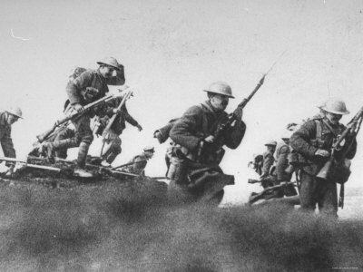
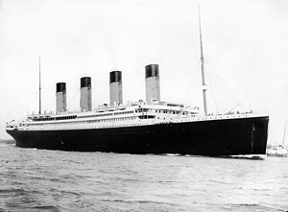
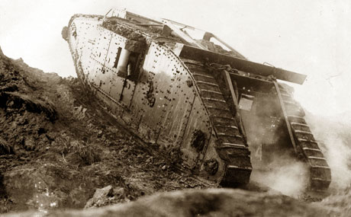
1912 – Titanic: technological advancement, hubris, and disaster
1914 - 1918 World War I, 16 million dead

Slide 3
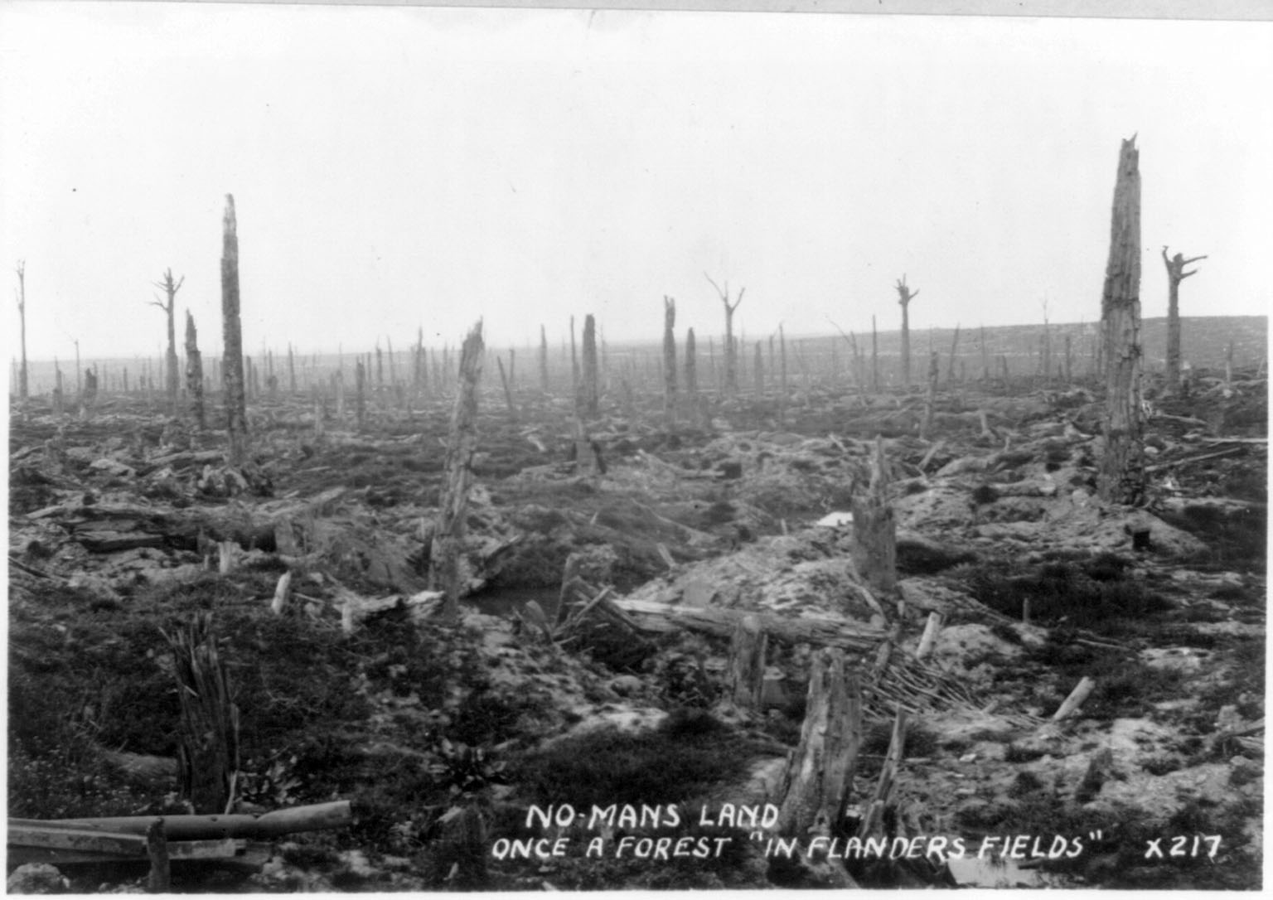
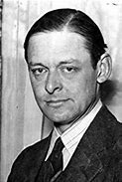
1922 – The Waste Land by T. S. Eliot (1888–1965)
“‘No Man’s Land – once a forest ‘in Flanders Fields’”
What is that sound high in the air Murmur of maternal lamentation Who are those hooded hordes swarming Over endless plains, stumbling in cracked earth Ringed by the flat horizon only 370 What is the city over the mountains Cracks and reforms and bursts in the violet air Falling towers Jerusalem Athens Alexandria Vienna London 375 Unreal
……
I sat upon the shore Fishing, with the arid plain behind me Shall I at least set my lands in order? 425 London Bridge is falling down falling down falling down
……

Slide 4
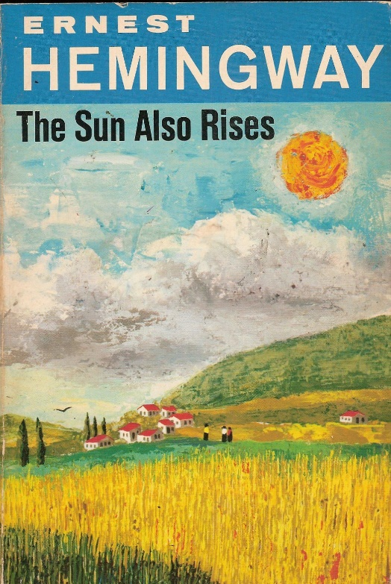
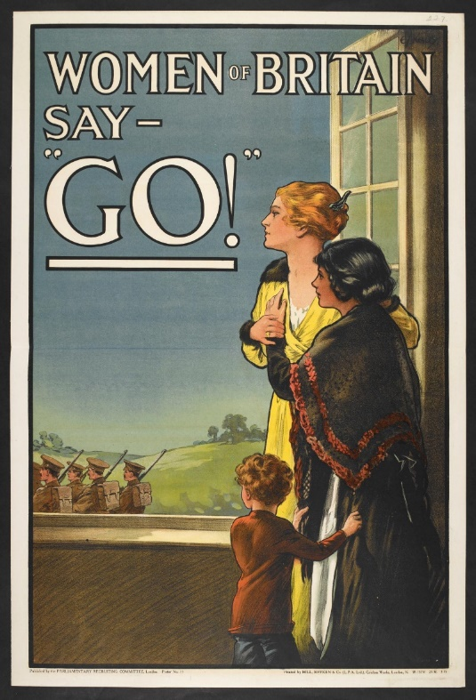
The Lost Generation
Gertrude Stein and Ernest Hemingway made the term widely known in America and beyond.
In 1917 one million women worked in British factory jobs. Many of the men never came home.
Many upper-class young officers died, leading to class changes.
The effects of war changed the generation, leaving many with disabilities and mental health problems.

Slide 5
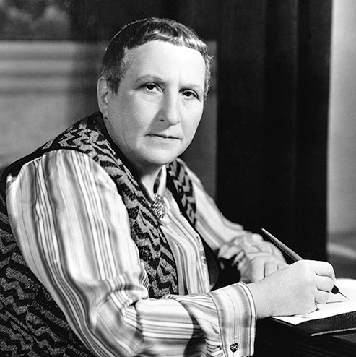
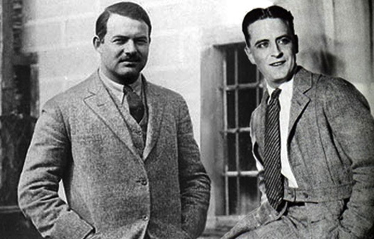
Paris in the 1920s
Gertrude Stein (1874-1946), an influential modernist, collected post-impressionist art, and set up a ‘salon’ in Paris, promoting writers such as Hemingway and Fitzgerald.
This decade is sometimes termed, ‘the roaring twenties’.
Both writers would write of the excesses of the time, and the struggle to find meaning – ‘the lost generation’.

Slide 6
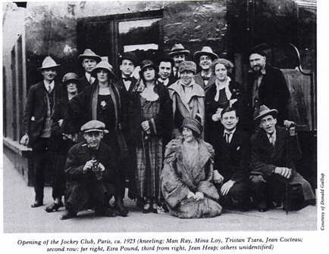
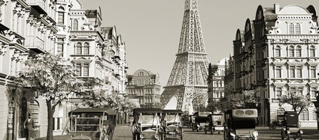
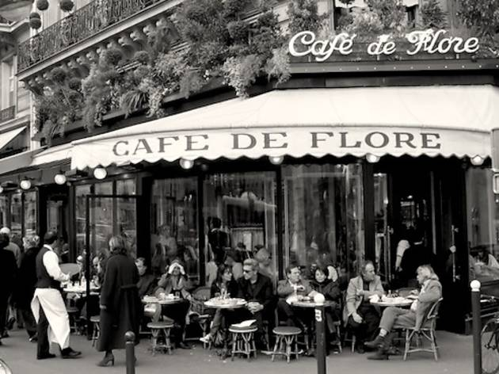
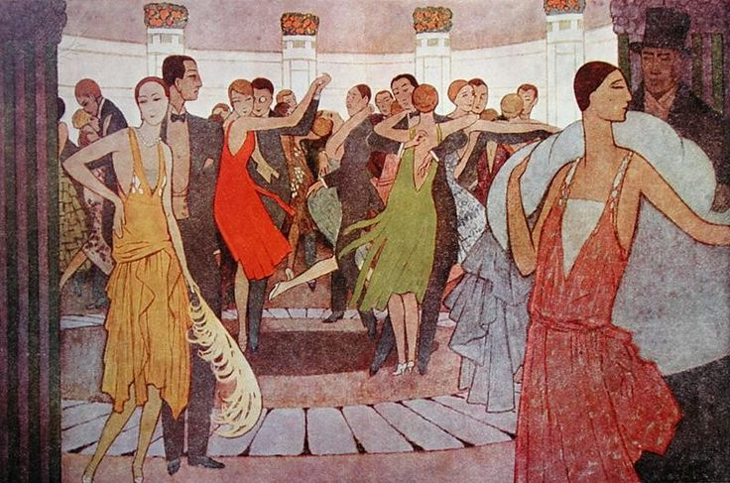

Slide 7
Modernist Change – Evident in the arts and architecture

Slide 8
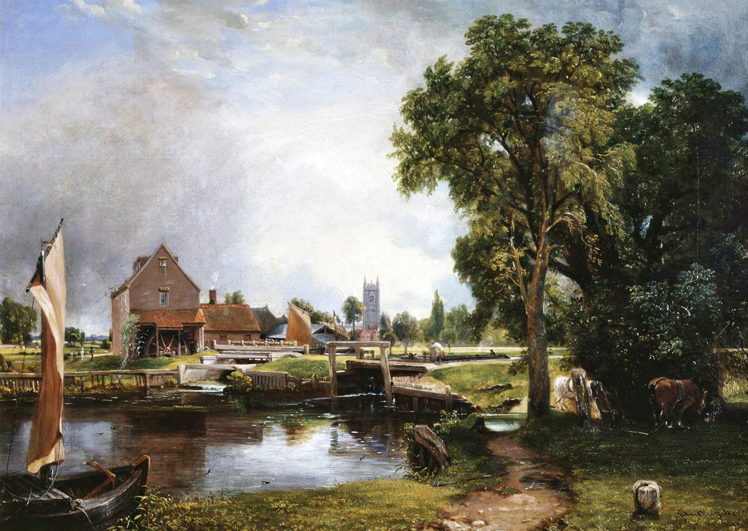
1837 – John Constable – Romantic era

Slide 9
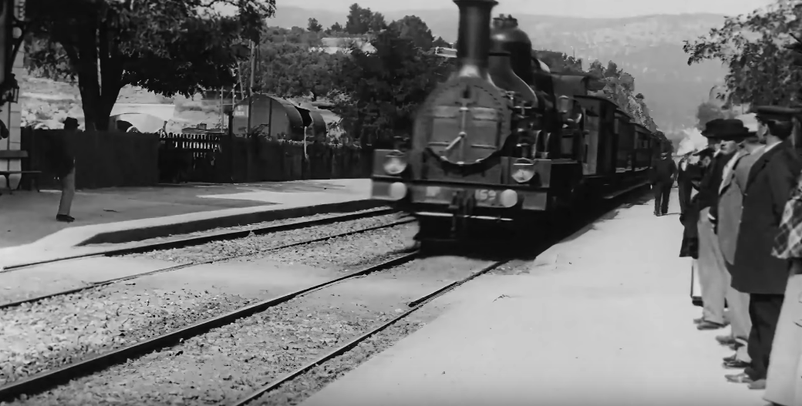
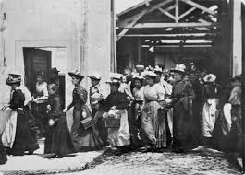
1895 - The Lumiere brothers make the first films
The new technology could record an impression of reality exactly.
The Arrival of a Train (1896) Workers Leaving the Factory (1895)

Slide 10

1920 – Water Lilies, Claude Monet – Impressionism

Slide 11
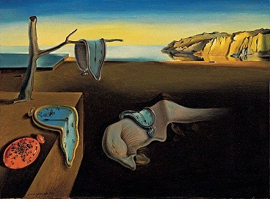
1931 – The Persistence of Memory, Salvador Dali

Slide 12
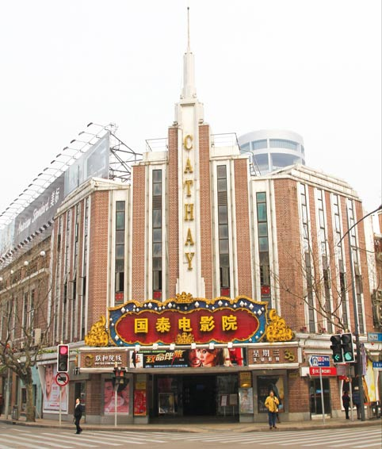
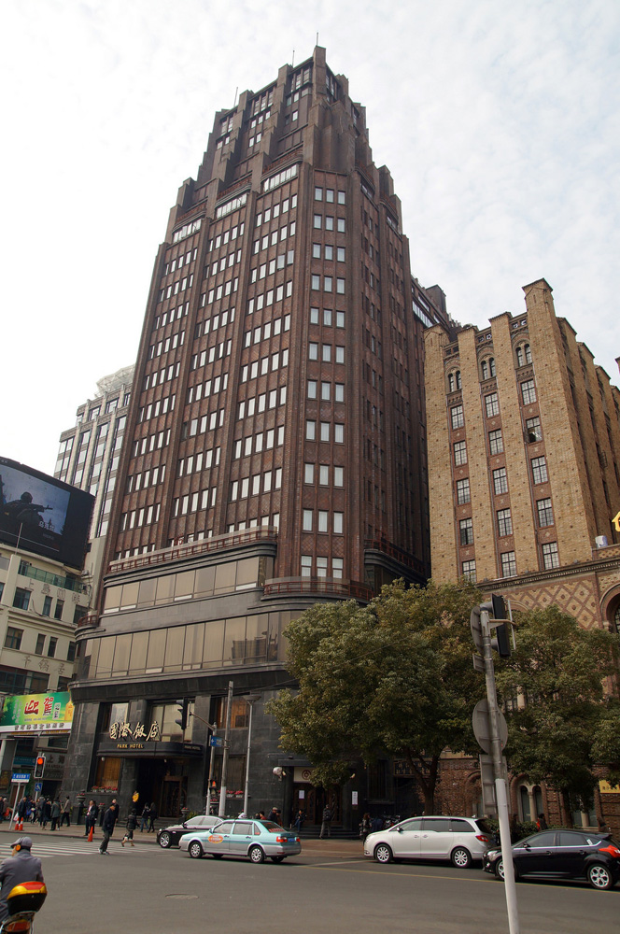
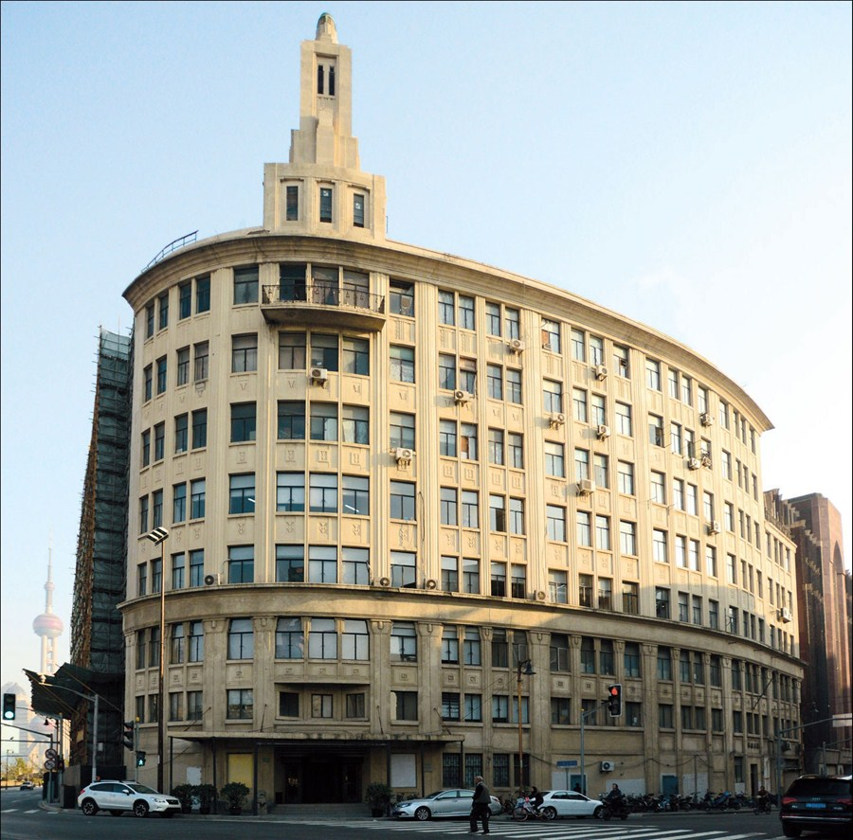
Cubist Architecture in Shanghai (and Art Deco)

Slide 13

Pablo Picasso
1937
Cubism
“It was the deep
reality, not the
superficial one.”

Slide 14
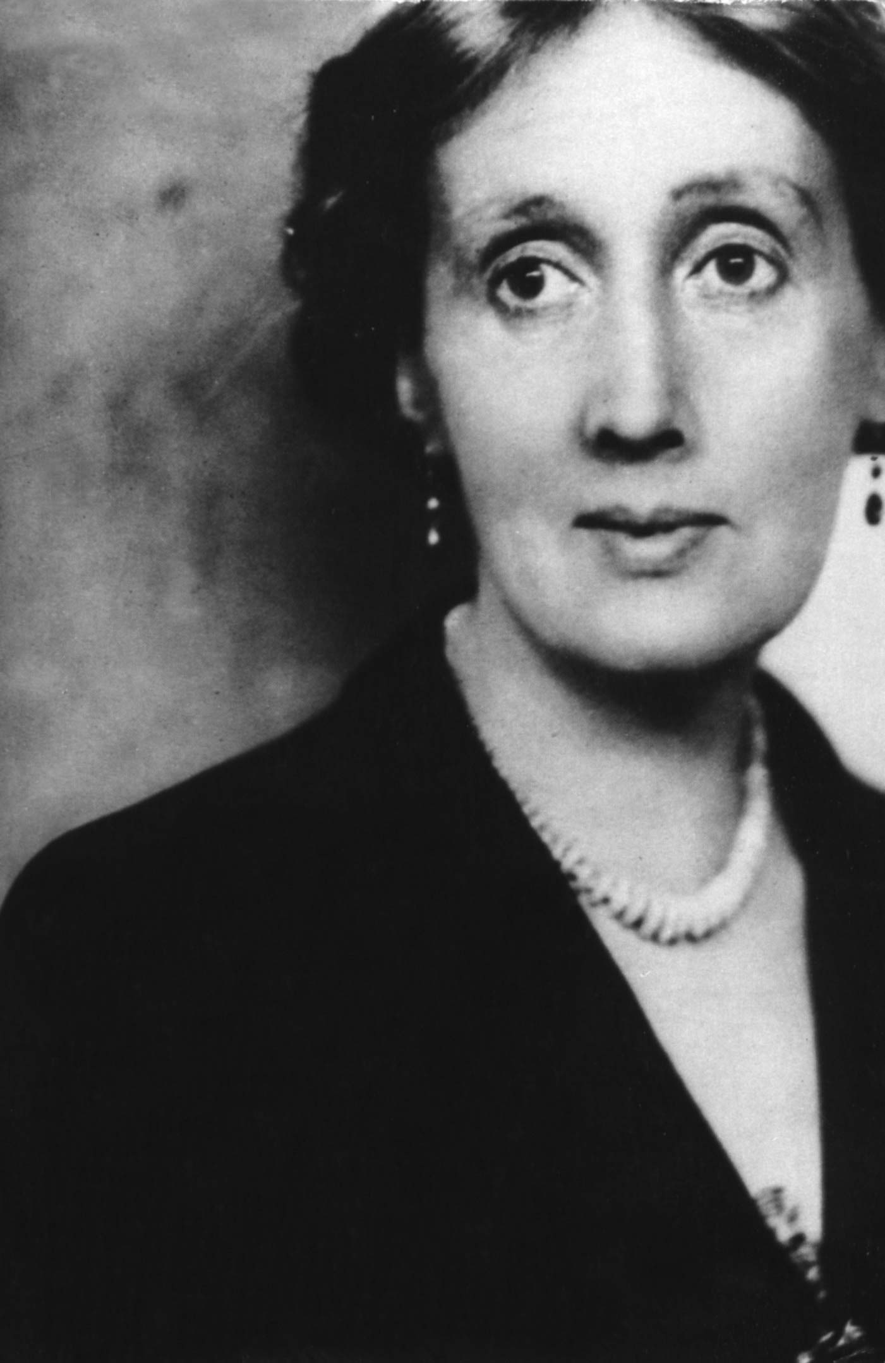
Virginia Woolf
Lived 1882 – 1941
A British writer.
One of the most famous modernists, and feminists.
She committed suicide by drowning herself.

Slide 15
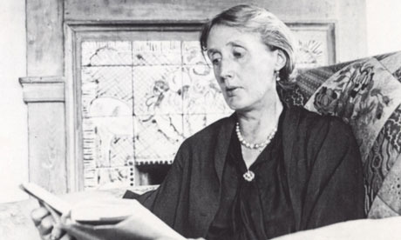
Virginia Woolf 1882-1941
She is known for a style of
‘stream of consciousness.’
Excerpt from To the Lighthouse (1927) : “But it may be fine — I expect it will be fine,” said Mrs. Ramsay, making some little twist of the reddish brown stocking she was knitting, impatiently. If she finished it tonight, if they did go to the Lighthouse after all, it was to be given to the Lighthouse keeper for his little boy, who was threatened with a tuberculous hip; together with a pile of old magazines, and some tobacco, indeed, whatever she could find lying about, not really wanted, but only littering the room, to give those poor fellows, who must be bored to death sitting all day with nothing to do but polish the lamp and trim the wick and rake about on their scrap of garden, something to amuse them. For how would you like to be shut up for a whole month at a time, and possibly more in stormy weather, upon a rock the size of a tennis lawn?

Slide 16
Virginia Woolf 1882-1941
‘Free indirect discourse’: when the narrator’s voice becomes the inner voice of a character. It allows ‘interior monologue’.
Excerpt from To the Lighthouse (1927) : “But it may be fine — I expect it will be fine,” said Mrs. Ramsay, making some little twist of the reddish brown stocking she was knitting, impatiently. If she finished it tonight, if they did go to the Lighthouse after all, it was to be given to the Lighthouse keeper for his little boy, who was threatened with a tuberculous hip; together with a pile of old magazines, and some tobacco, indeed, whatever she could find lying about, not really wanted, but only littering the room, to give those poor fellows, who must be bored to death sitting all day with nothing to do but polish the lamp and trim the wick and rake about on their scrap of garden, something to amuse them. For how would you like to be shut up for a whole month at a time, and possibly more in stormy weather, upon a rock the size of a tennis lawn?

Slide 17
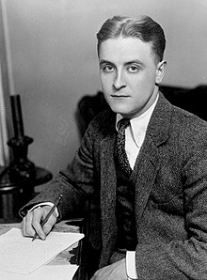
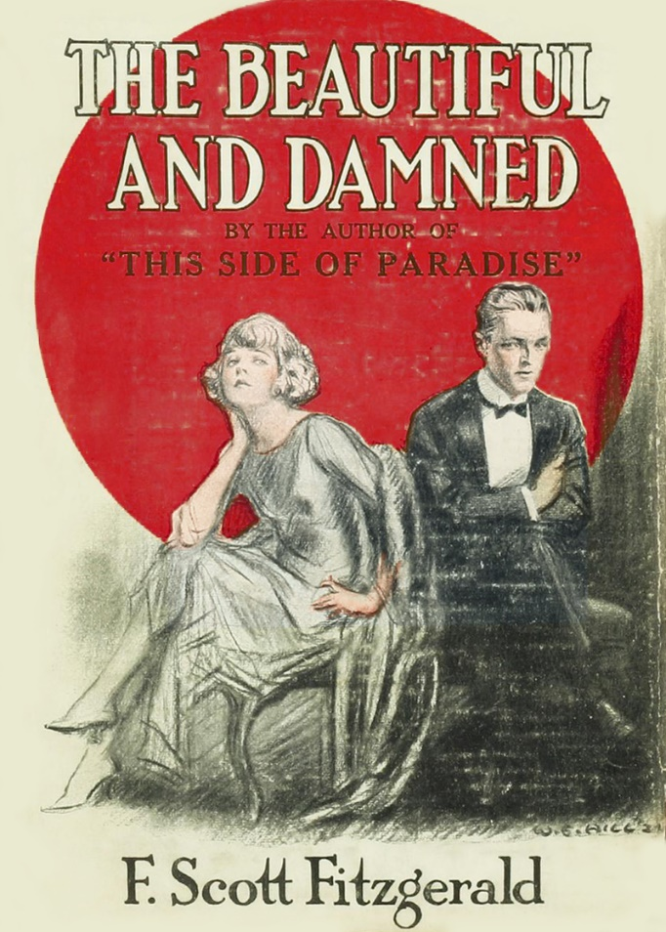
F. Scott Fitzgerald
Lived 1896 – 1940.
Considered a representative of ‘the lost generation’ – those who lived after World War I.
Married a socialite, Zelda ‘Fitzgerald’.

Slide 18
The Great Gatsby (1925)
Describe the character of Gatsby.
Does the writing create a sense of realism? Why or why not?
What is the symbolism of the party, of the library, and of Gatsby?

Slide 19

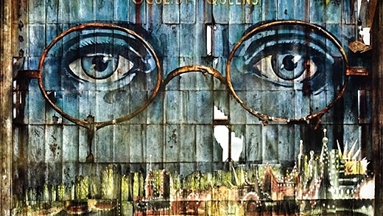
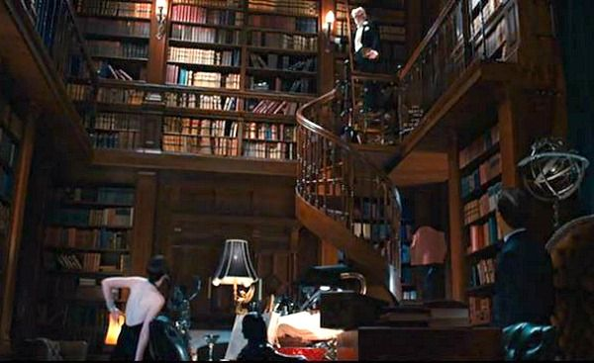
Realism and Symbolism
Symbolism in the book and movie: The green light across the bay where Daisy lives; large eyes on an advertising billboard overlooking the road; Gatsby’s library stocked full of books, real, but never read.

Slide 20
How do we express reality in language?
Is it by describing exactly what we see, by observation and objectivity…? Exactly what people say and do…
Should we take that realism and put it into a literary form and style that is more enjoyable to read?
Is it by showing how we as individuals experience reality? Our thought processes of reality… ‘stream of consciousness’… emotion and metaphor and simile…?
What is the most effective structure to capture reality, real experience, and make it effective and readable?

Slide 21
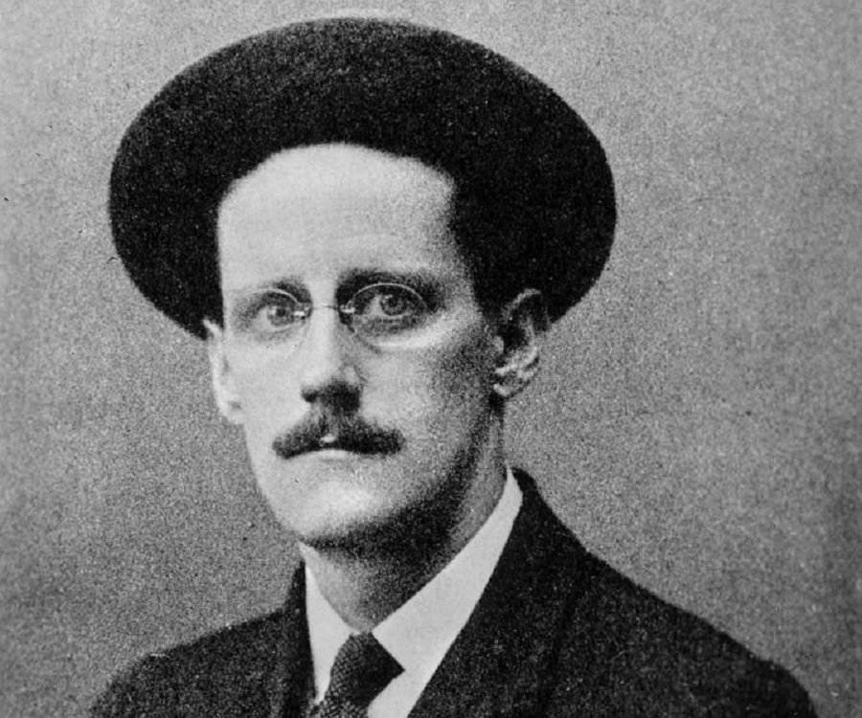
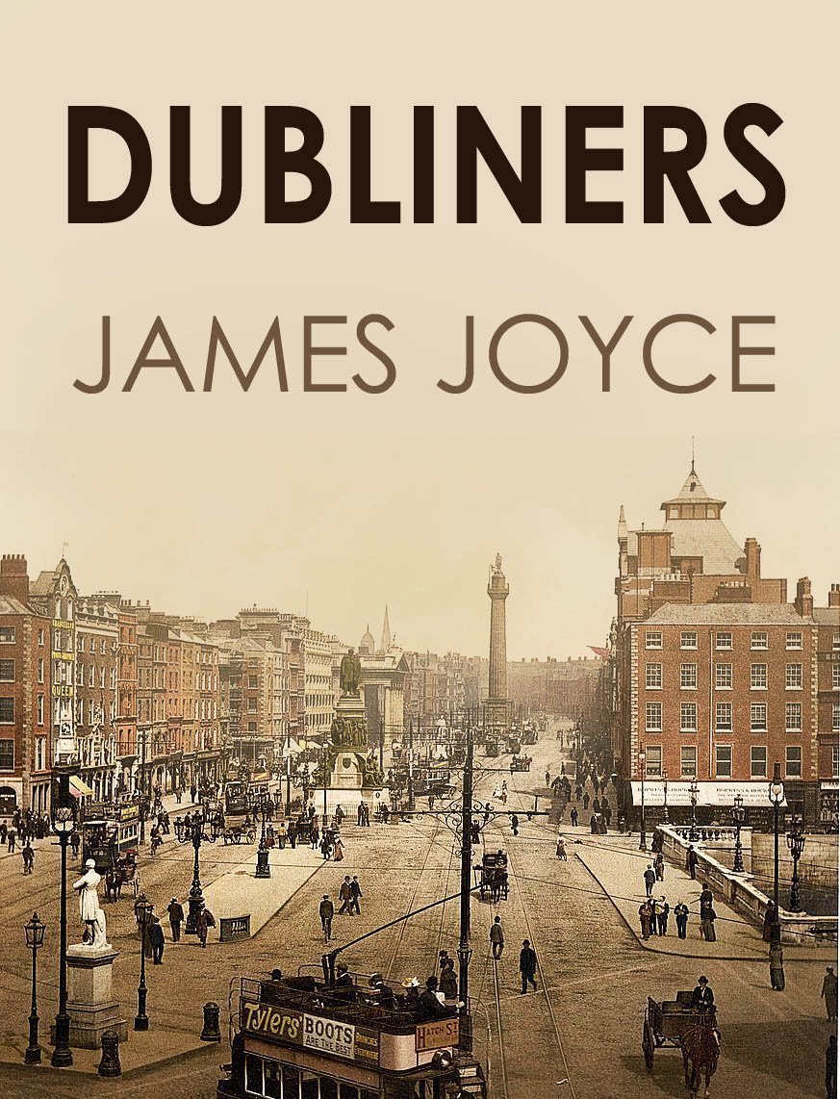
James Joyce
Lived 1882 – 1941
He wrote experimental ‘Modernist’ fiction. Ulysses, (1922) for example, features different styles, such as stream of consciousness.
He was influenced by the Modernist movements of the Realists and the Symbolists.

Slide 22
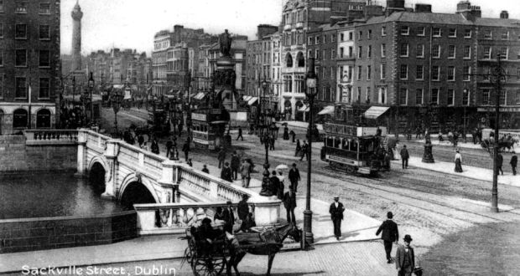
Dubliners (1914)
Many of the short stories in the book feature moments of ‘epiphany’.
In Eveline, the short story tells of a young woman in Dublin who must decide whether to leave, or stay.
How are mood, tone, and theme created?
What symbols are used for… the depression of Dublin ? …the old and the modern? …the chance to escape? …the choice she must decide?
How are colours used?
How is interior monologue (stream of consciousness) used?

Slide 23
Writing Practice
Academic question:
‘How can the cultural dislocation of the early twentieth century be seen to have shaped ‘modernist’ literature?’
Creative writing:
Write some stream of consciousness about a scene in which not much action happens.

Slide 24
Homework
Read the examples of postmodern poetry by Sylvia Plath and Seamus Heaney.

